Slide 1
Species traits and habitat quality drive differences in fish densities between visual survey techniques: implications for coral reef monitoring design George et al.
Figures

Slide 2
Model Plot

Slide 3
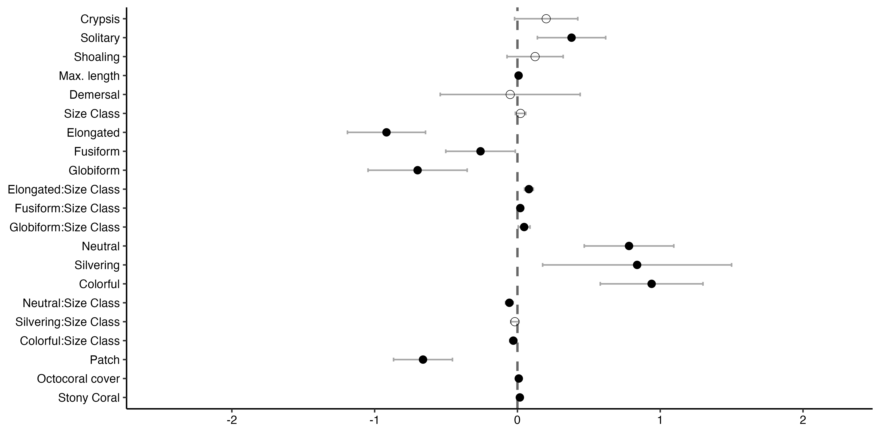
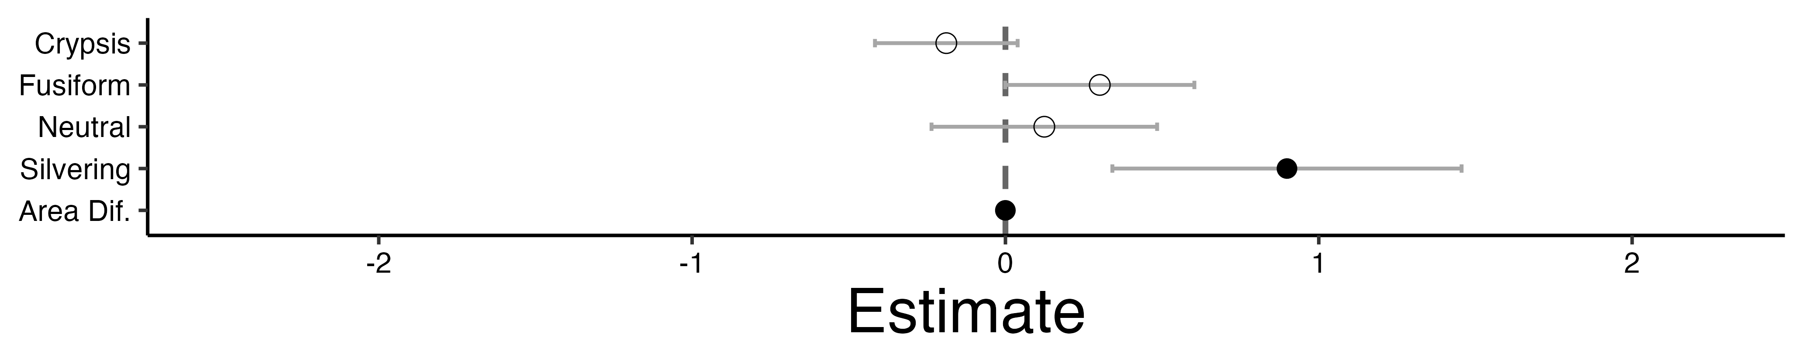
A.
Aggregation
schooling
benthic
Shape
compressiform
Species Traits
Coloration
camouflage
Habitat Traits
continuous
B.
Species Traits
anguilliform
Coloration
camouflage
Habitat Traits

Slide 4
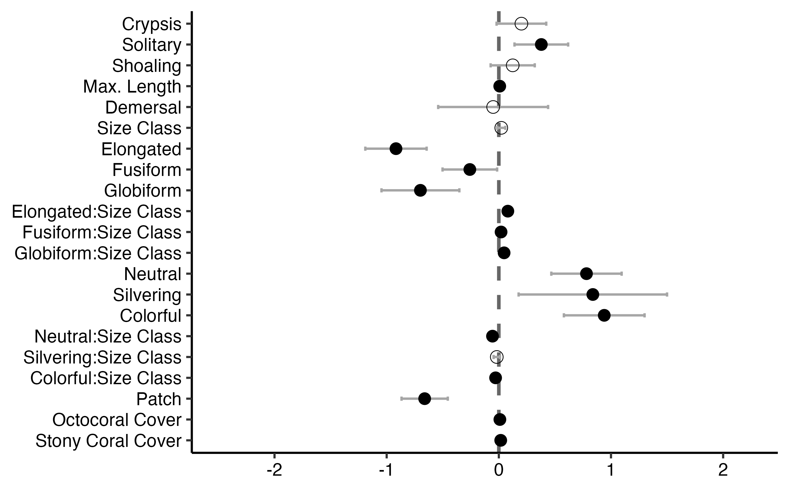
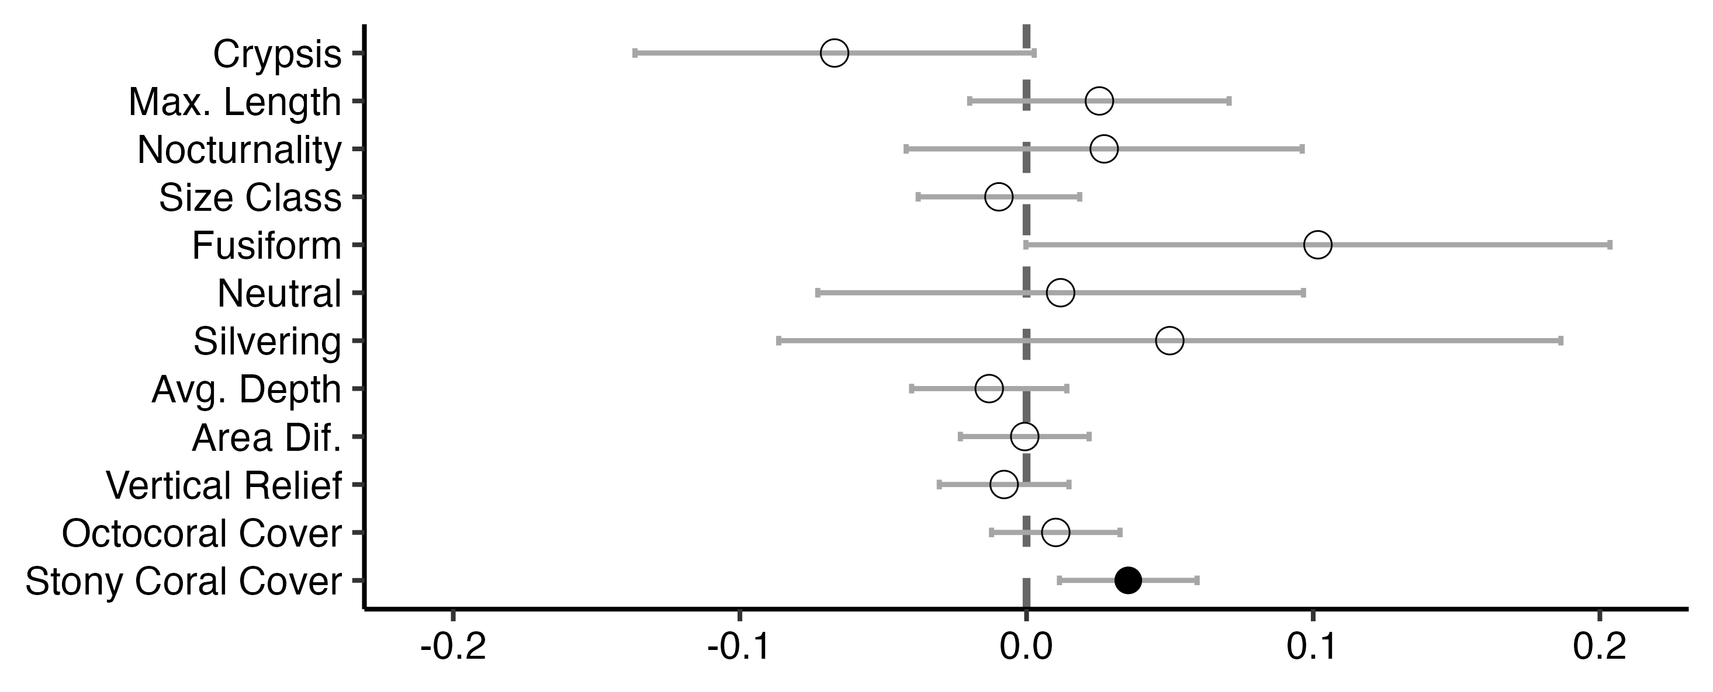
A.
Aggregation
schooling
benthic
Shape
compressiform
Species Traits
Coloration
camouflage
Habitat Traits
continuous
B.
Species Traits
Shape
anguilliform
Coloration
camouflage
Habitat Traits
Estimate

Slide 5
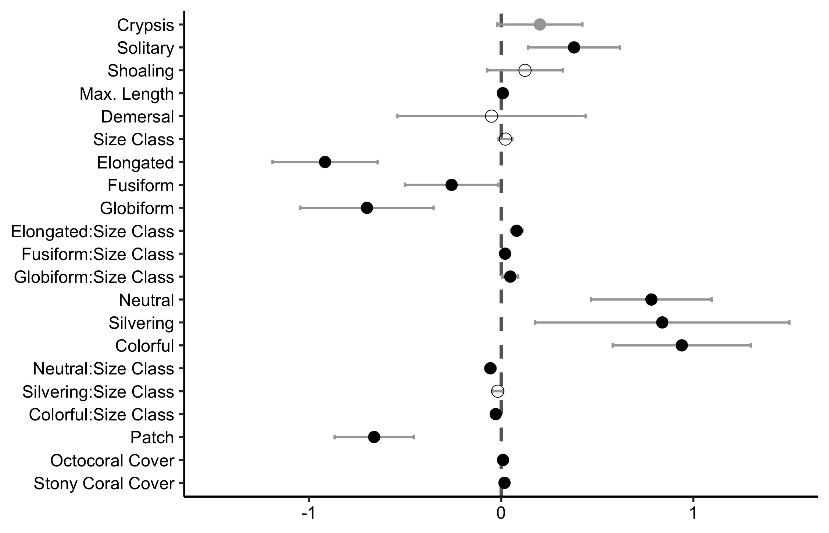
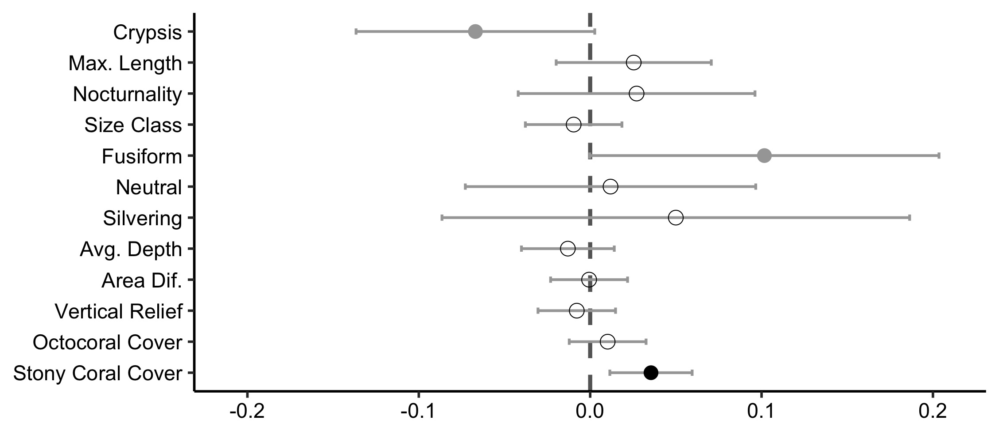
A.
Aggregation
schooling
benthic
Shape
compressiform
Species Traits
Coloration
camouflage
Habitat Traits
continuous
B.
Species Traits
Shape
anguilliform
Coloration
camouflage
Habitat Traits

Slide 6
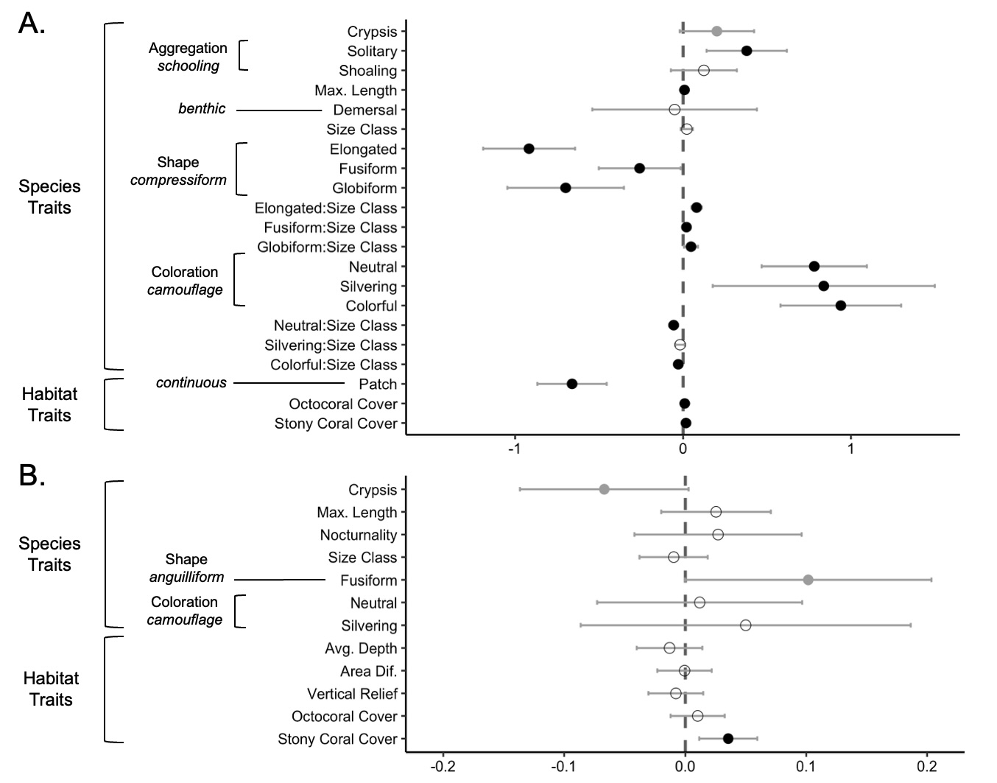
Estimate

Slide 7
SVC vs. Belt Fish Trait Plot

Slide 8
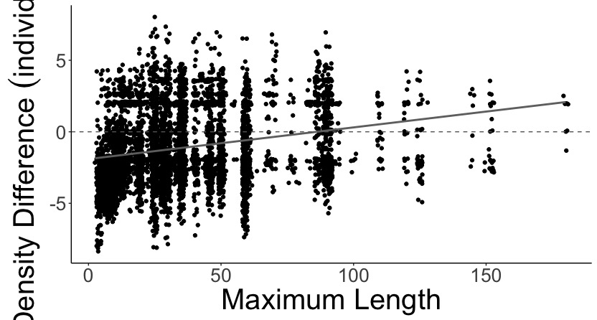
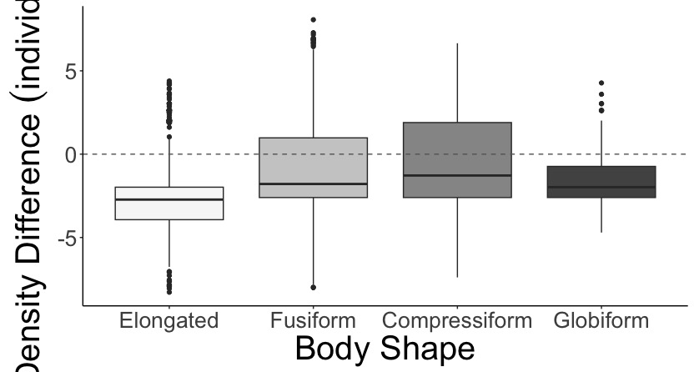
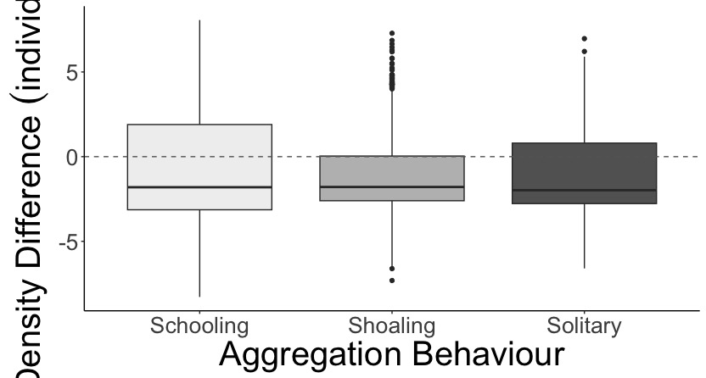
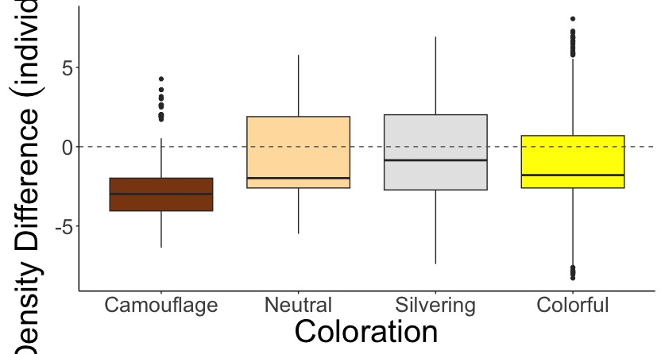
A.
B.
a
b
c
d
SVC Density Greater
SVC Density Greater
Belt Density Greater
Belt Density Greater
Log Density Difference (individuals/m²)
C.
a
a
a
D.
a
b
b
c
SVC Density Greater
SVC Density Greater
Belt Density Greater
Belt Density Greater

Slide 9
SVC vs. Belt Interactions Plot

Slide 10
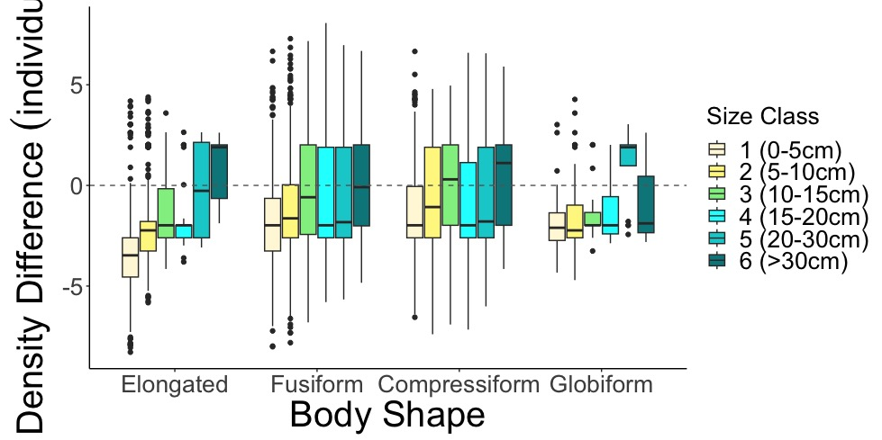
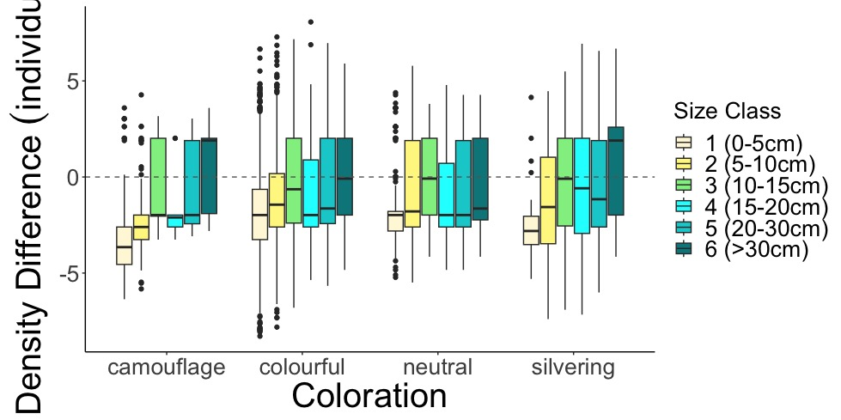
A.
SVC Density Greater
Belt Density Greater
Log Density Difference (individuals/m²)
B.
SVC Density Greater
Belt Density Greater

Slide 11
Heat Plot

Slide 12
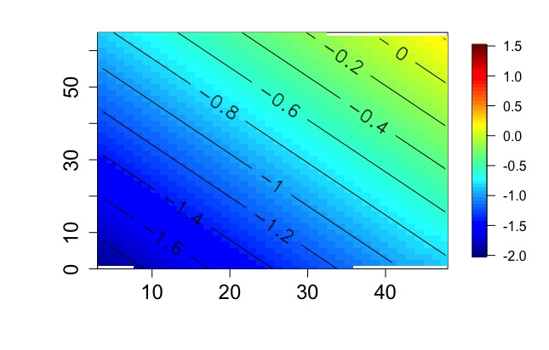
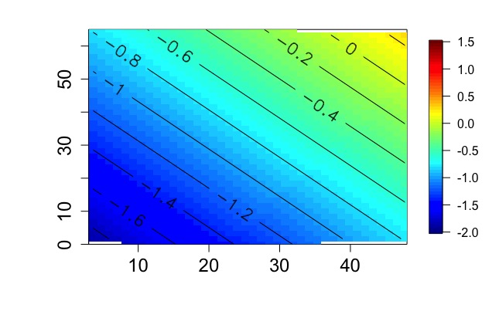
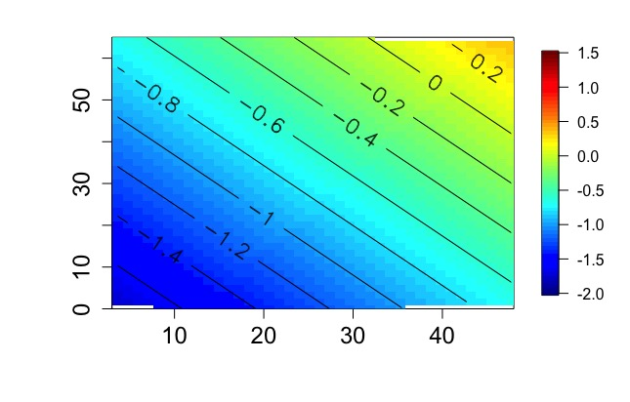
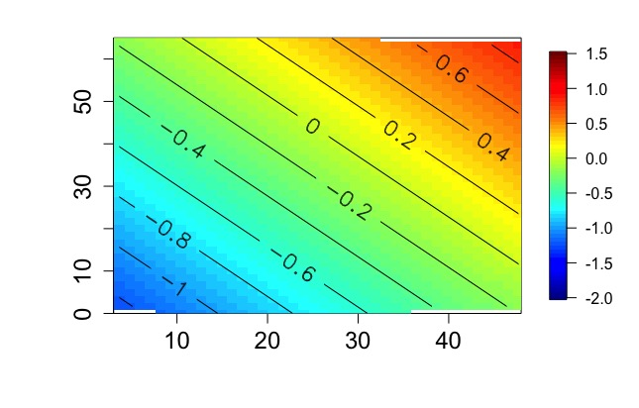
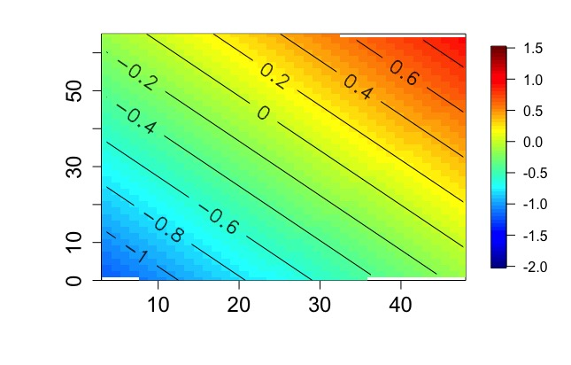
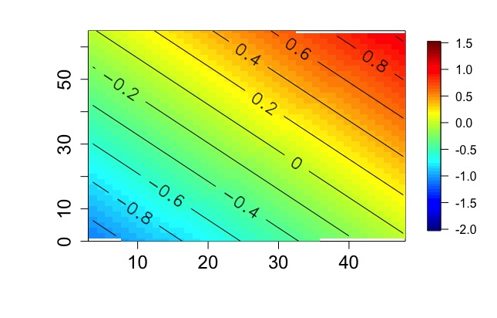
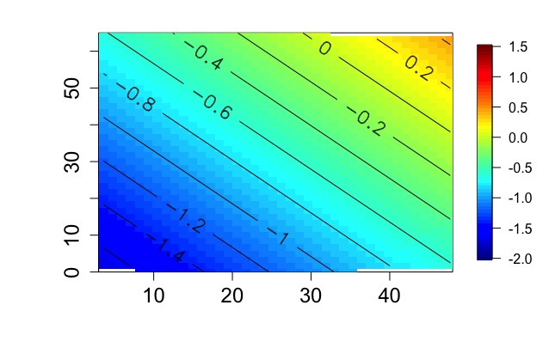

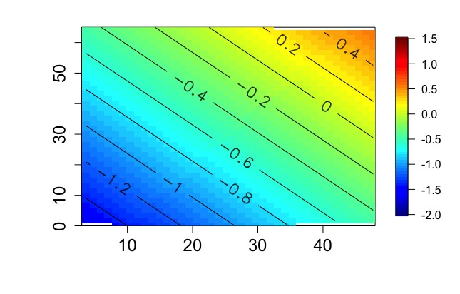
Neutral
Silvering
Colorful
A.
B.
C.
SVC Density Greater
Elongated
Belt Density Greater
D.
E.
F.
SVC Density Greater
Stony Coral Cover (%)
Fusiform
Log Density Difference (individuals/m²)
Belt Density Greater
G.
H.
I.
SVC Density Greater
Globiform
Belt Density Greater
Fish Size (cm)

Slide 13
SVC vs. Belt Habitat Traits Plot

Slide 14
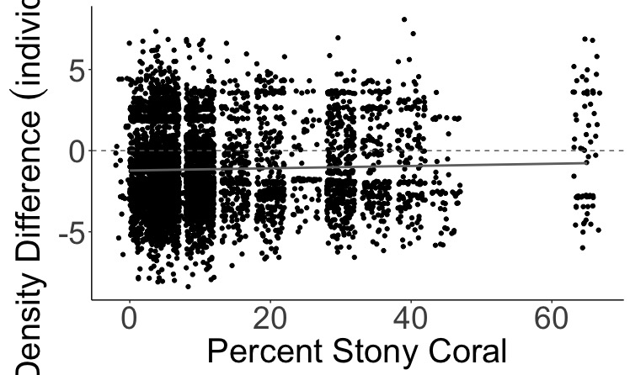
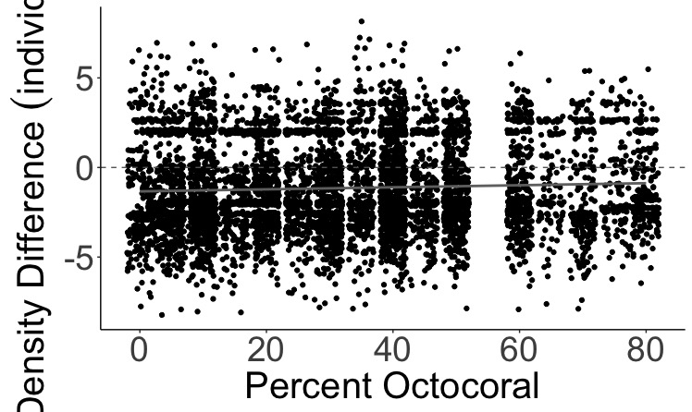
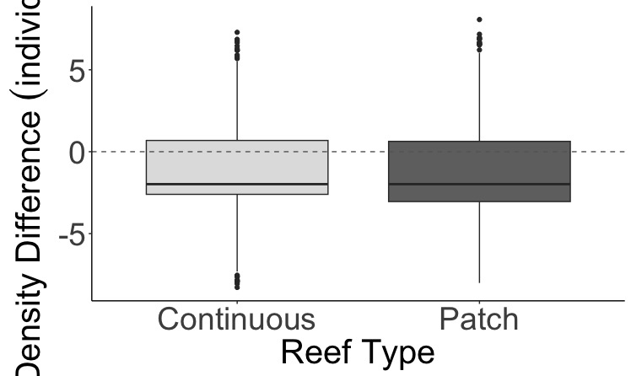
A.
SVC Density Greater
Belt Density Greater
B.
SVC Density Greater
Log Density Difference (individuals/m²)
Belt Density Greater
C.
a
b
SVC Density Greater
Belt Density Greater

Slide 15
SVC vs. Roving Traits Plot

Slide 16
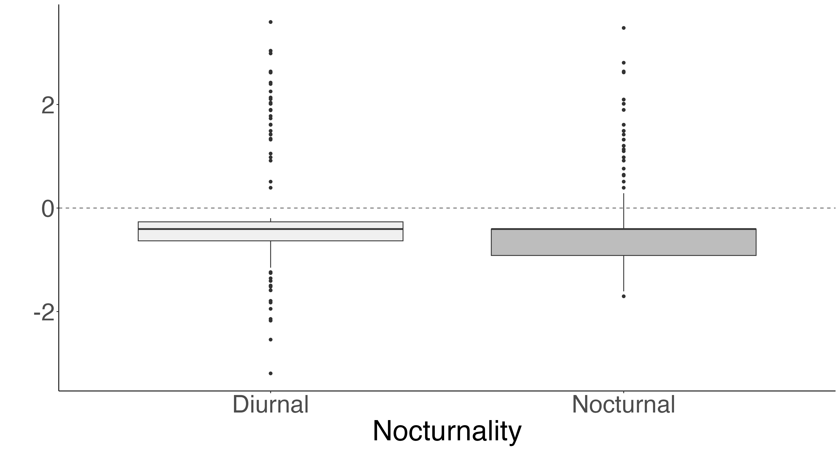
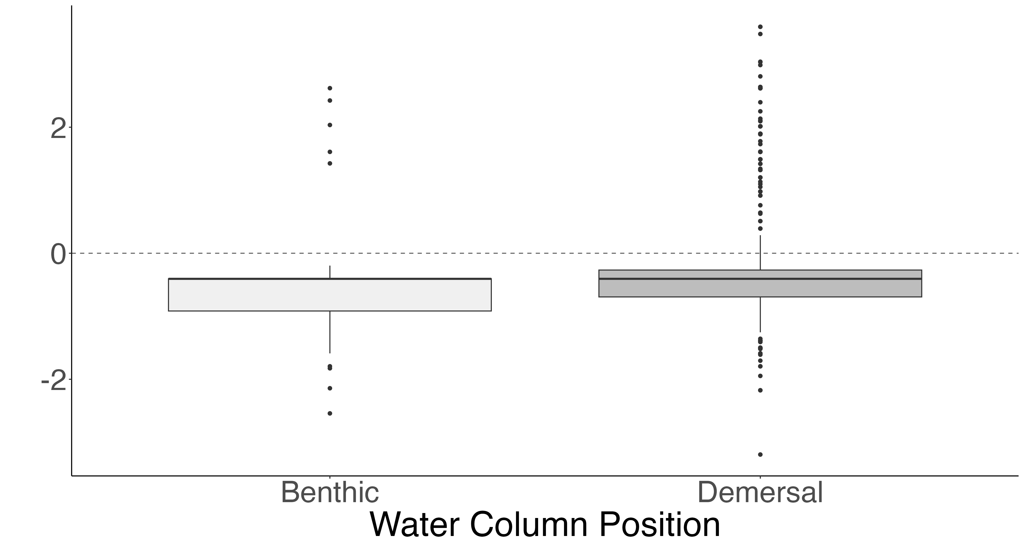
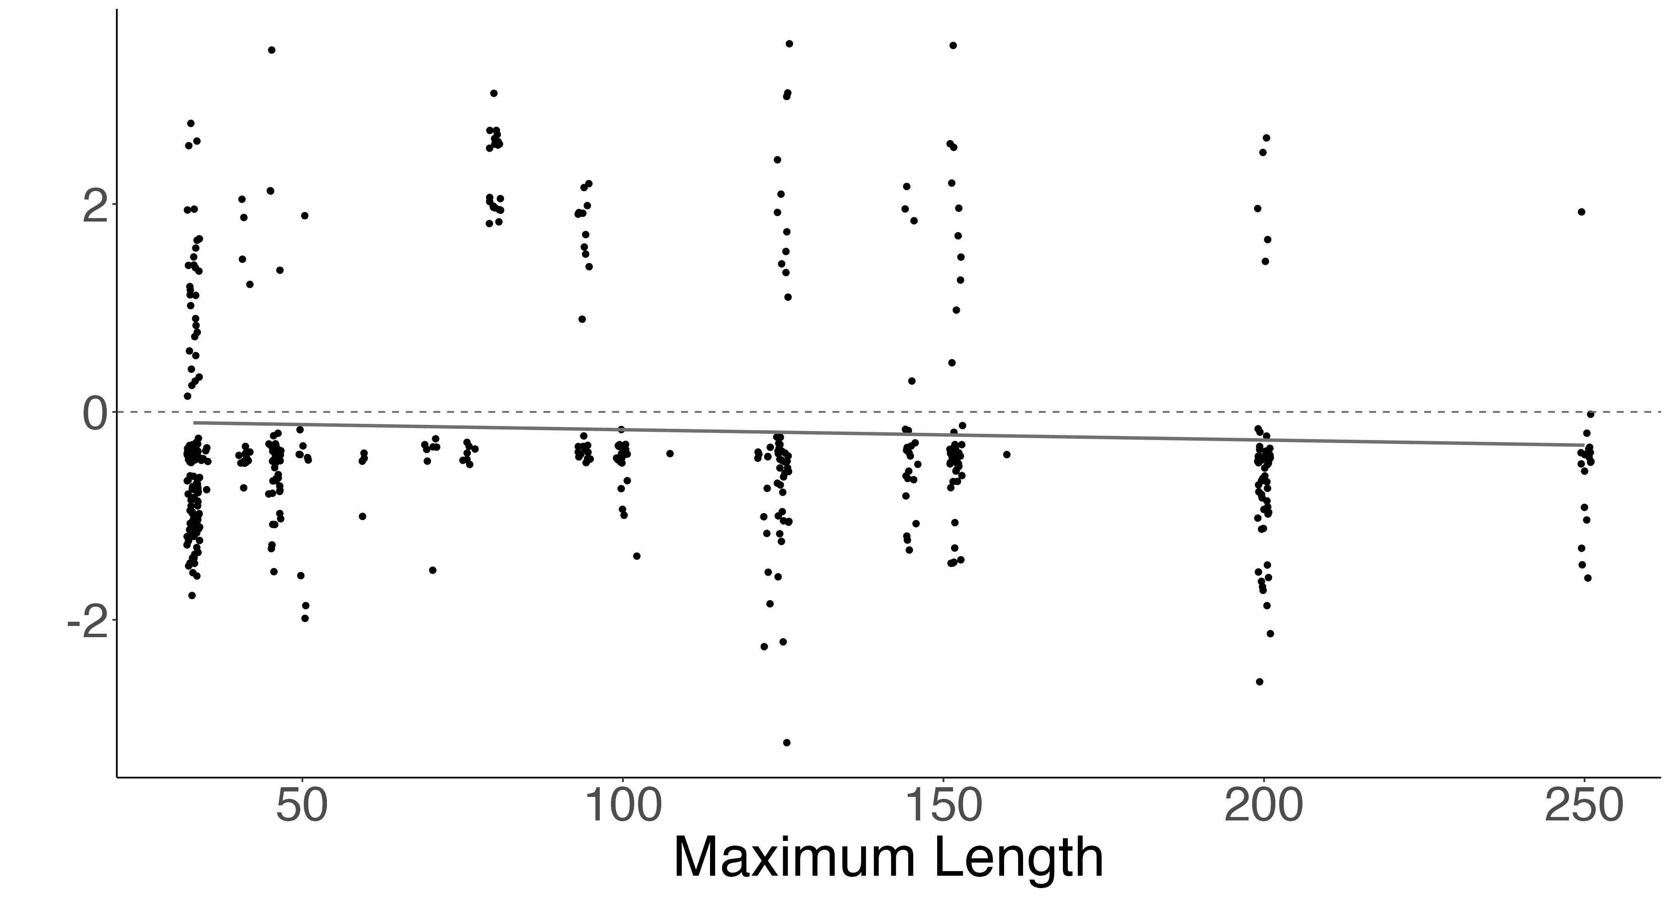
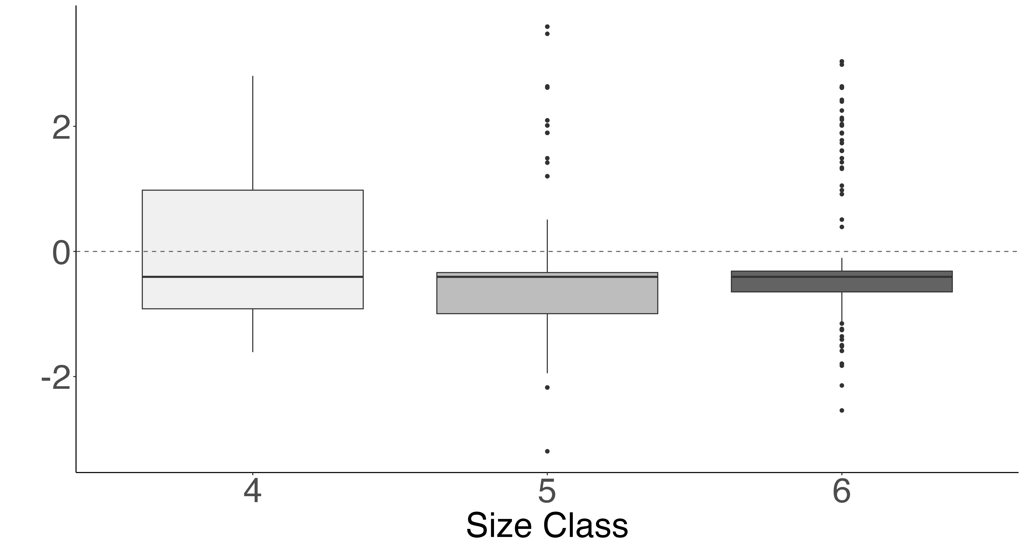
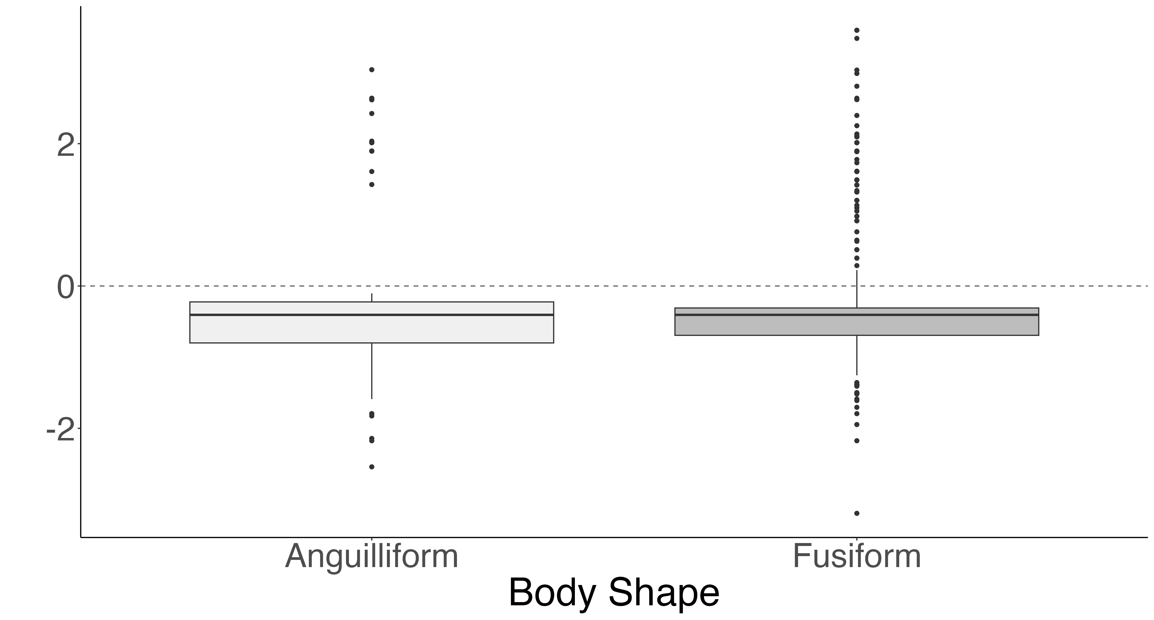
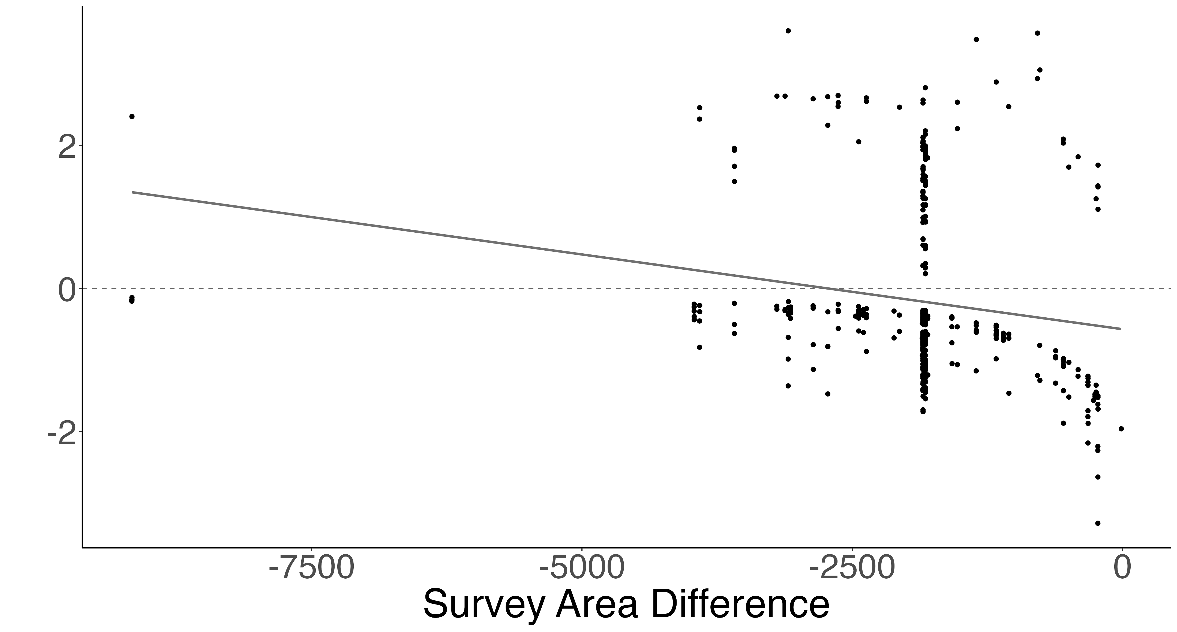
A.
a
b
B.
b
SVC Density Greater
a
SVC Density Greater
Roving Density Greater
Roving Density Greater
C.
estimate = 0.005 z-value = 4.67 p < 0.01
D.
a
SVC Density Greater
a
a
SVC Density Greater
Log Density Difference (individuals/m²)
Roving Density Greater
Roving Density Greater
E.
a
F.
estimate < 0.001 z-value = 4.64 p < 0.01
a
SVC Density Greater
SVC Density Greater
Roving Density Greater
Roving Density Greater

Slide 17
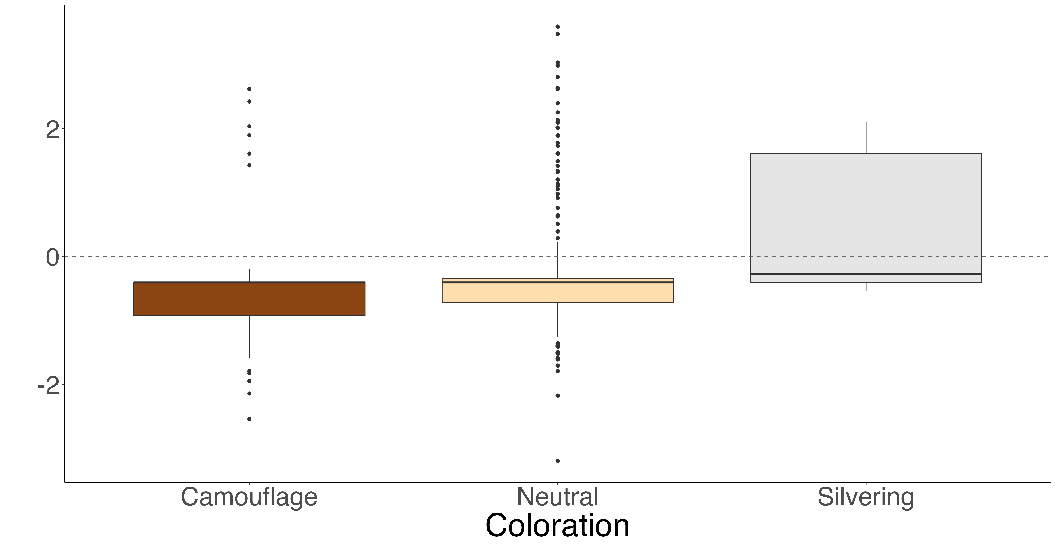
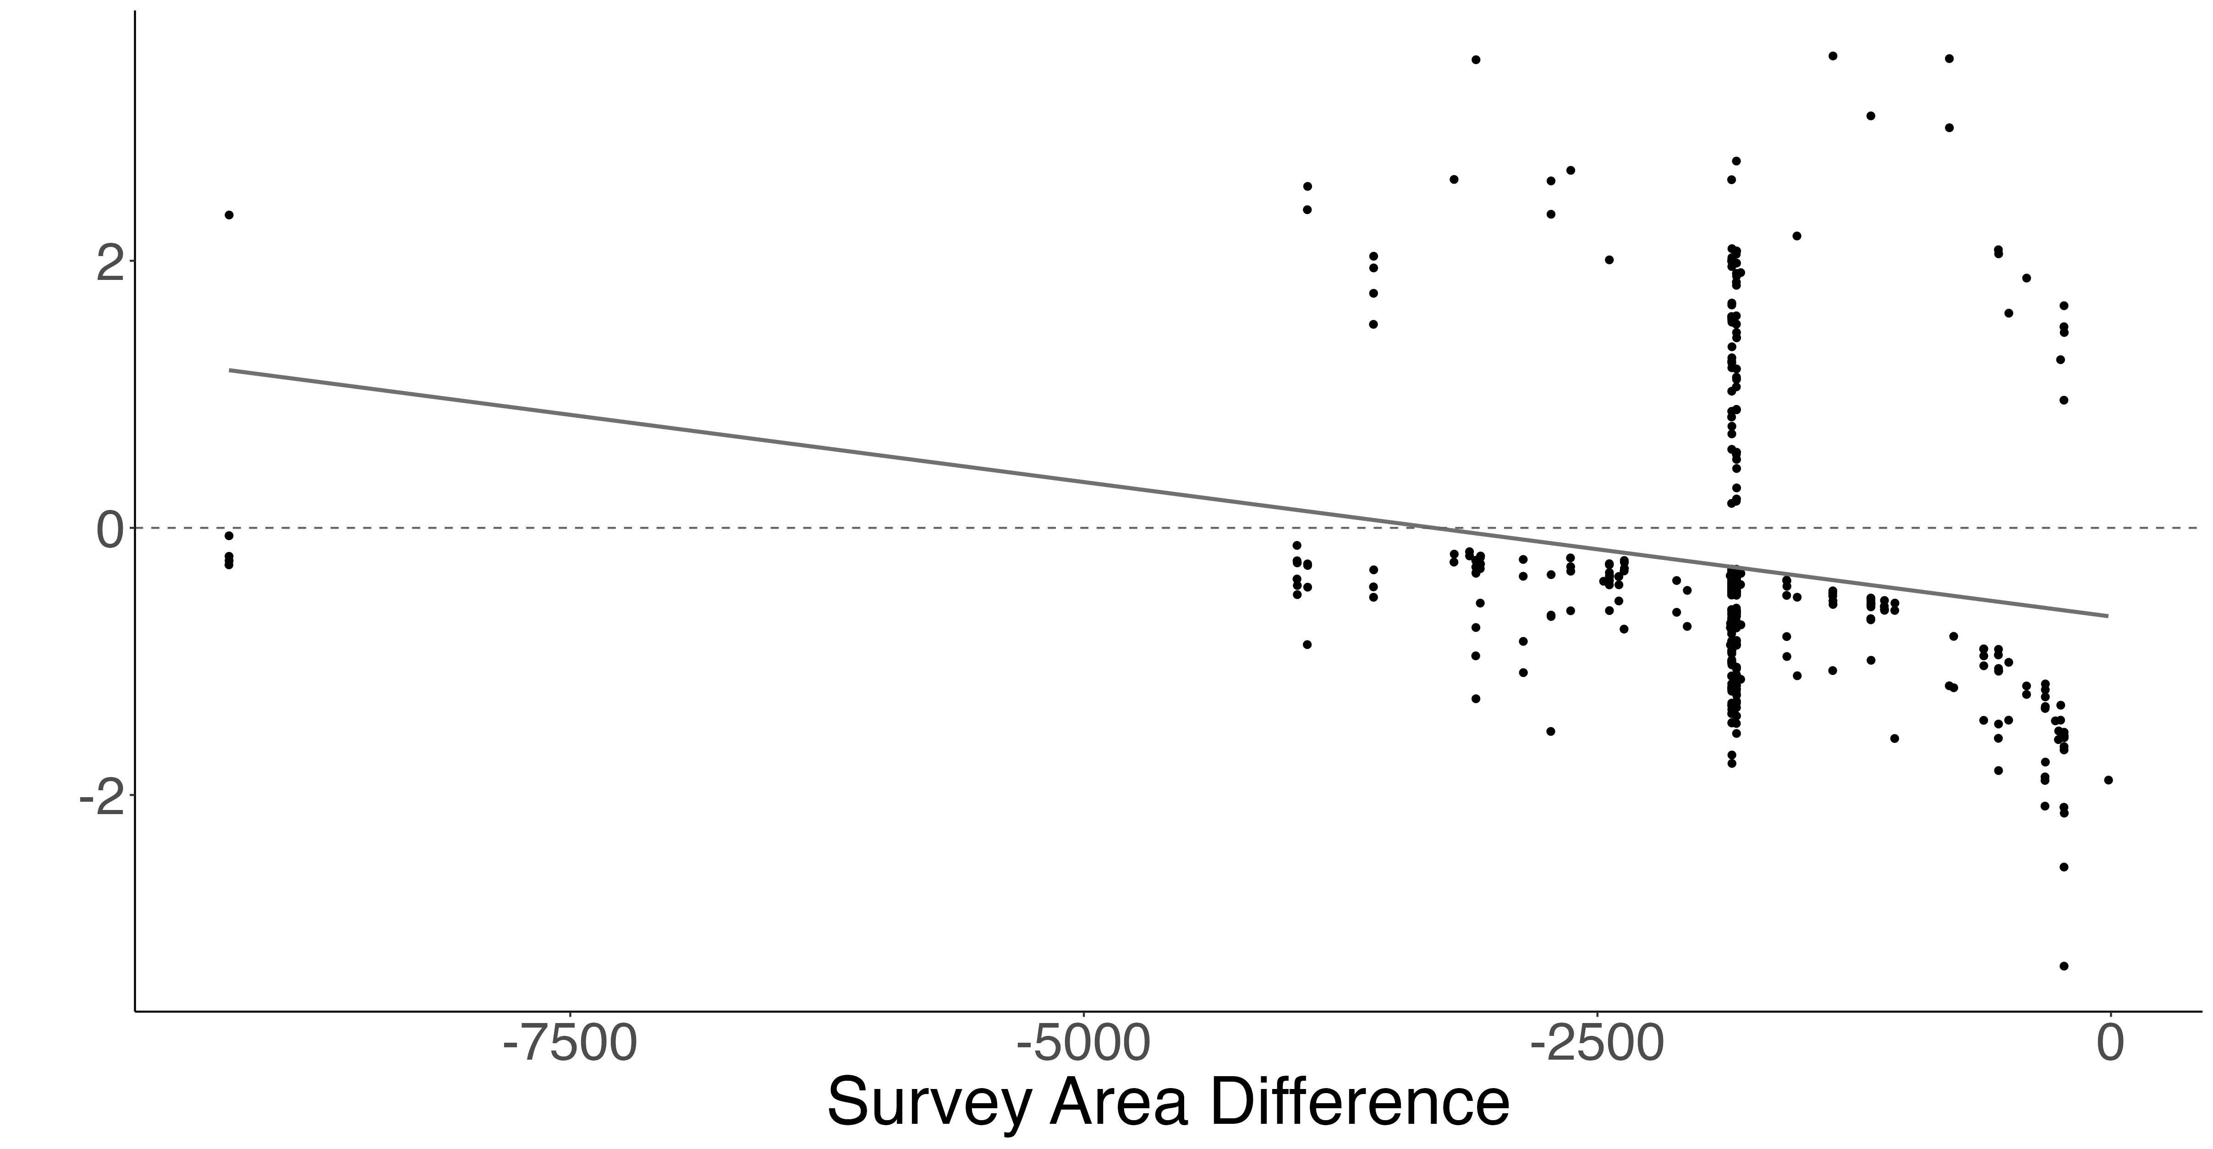
A.
a
a
b
SVC Density Greater
Roving Density Greater
Log Density Difference (individuals/m²)
B.
SVC Density Greater
estimate < 0.001
z-value = 4.703
p < 0.01
Roving Density Greater

Slide 18
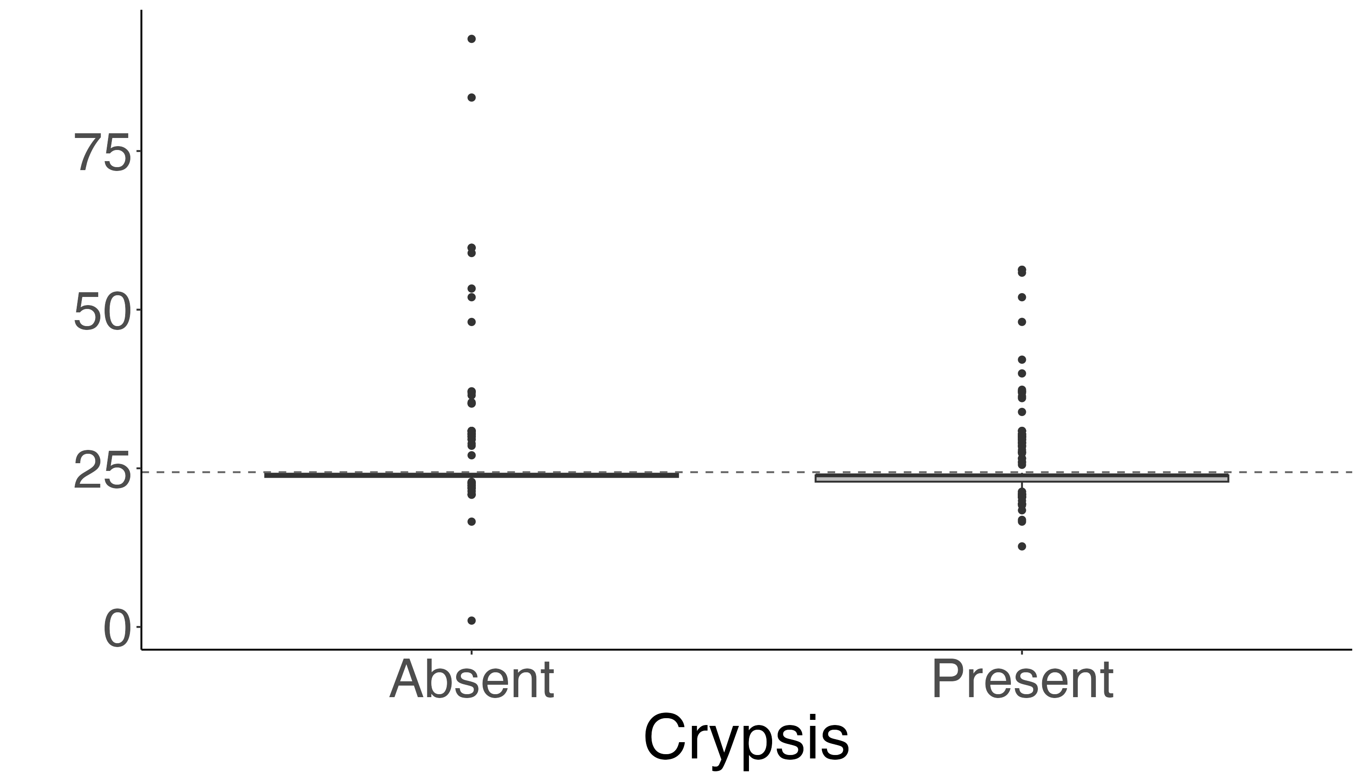
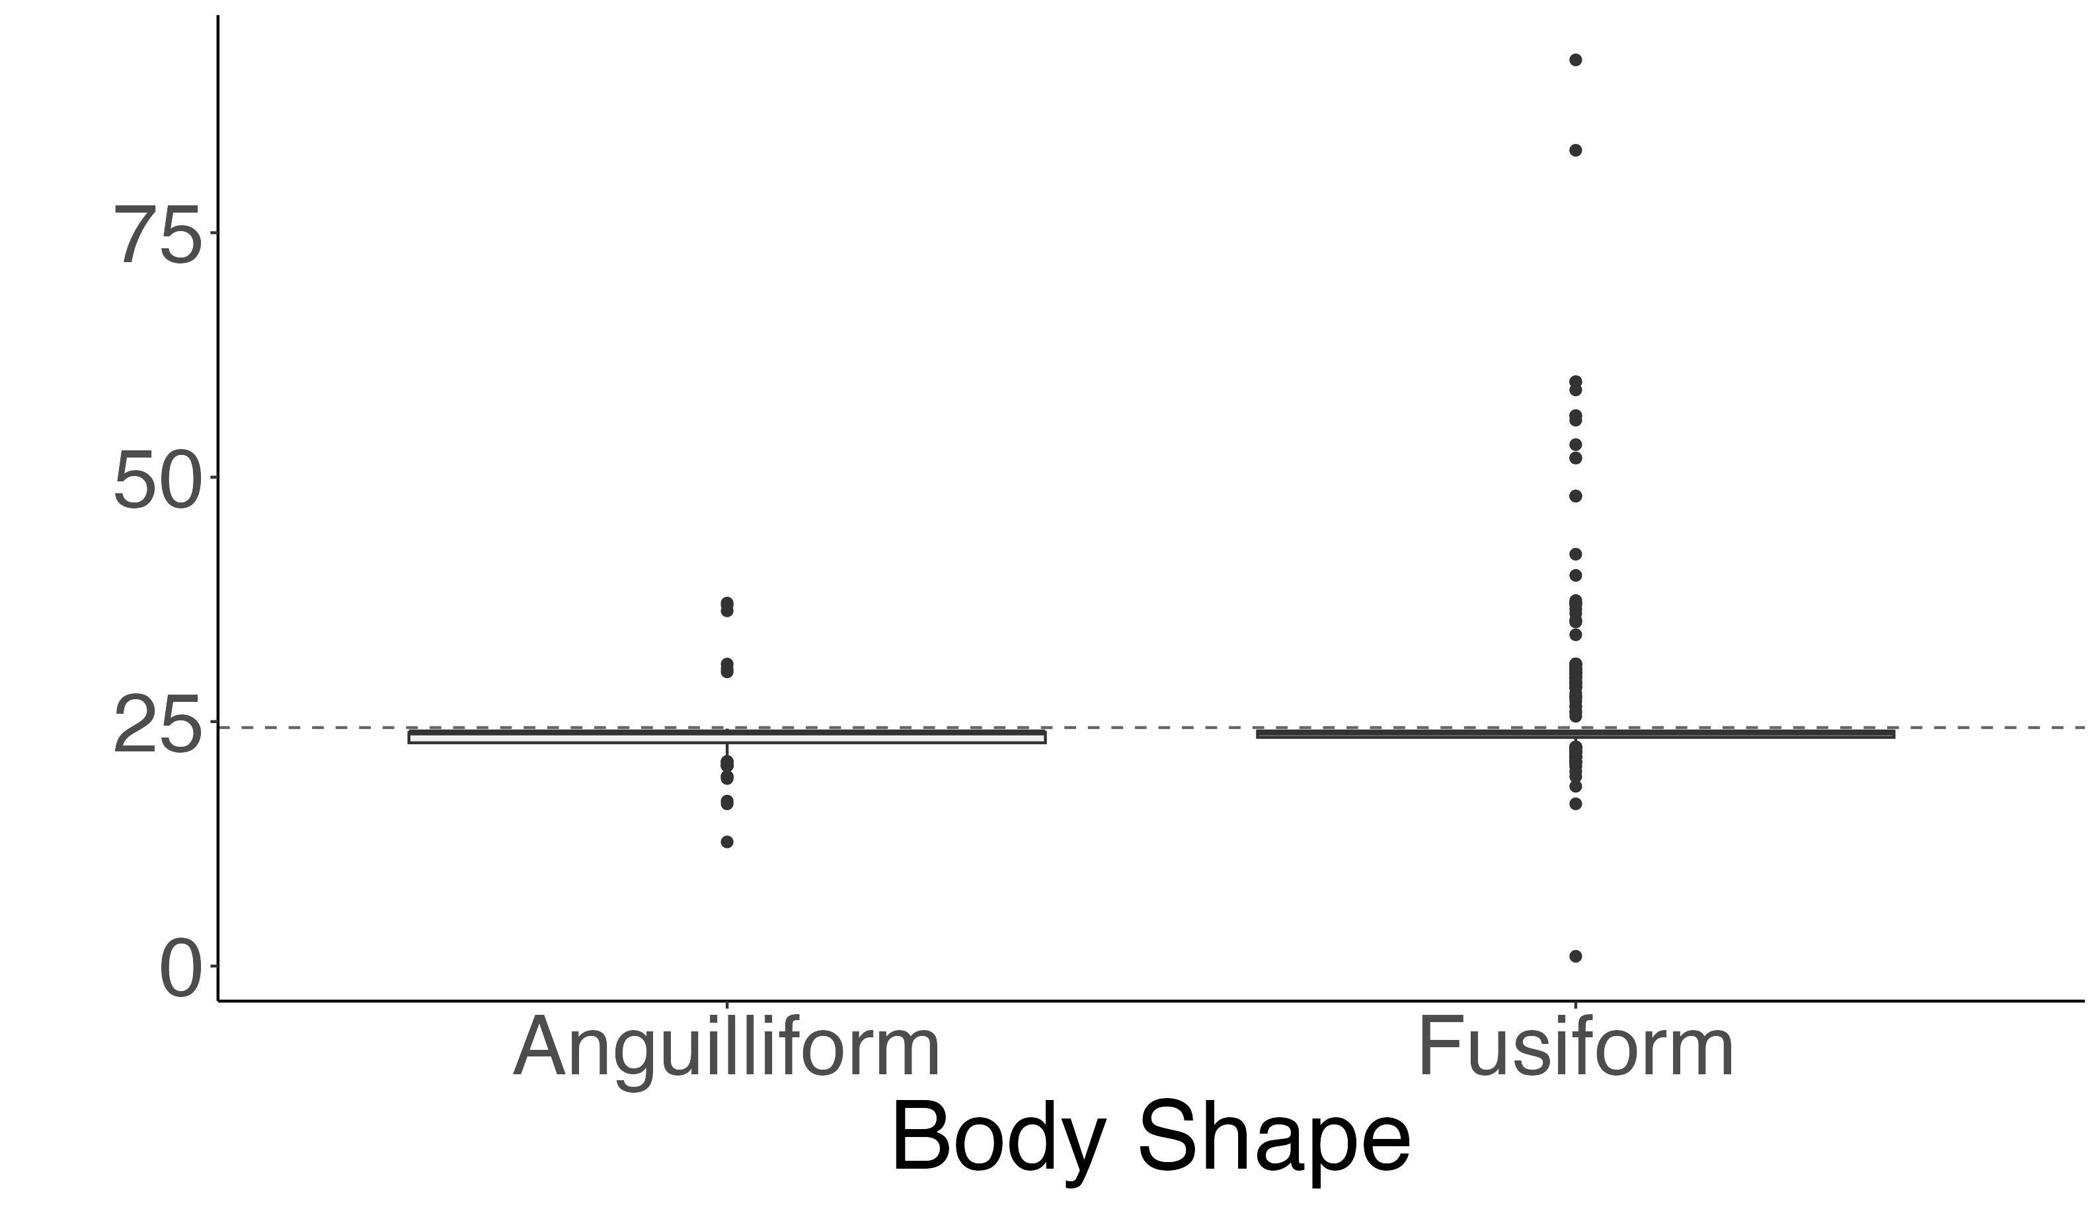
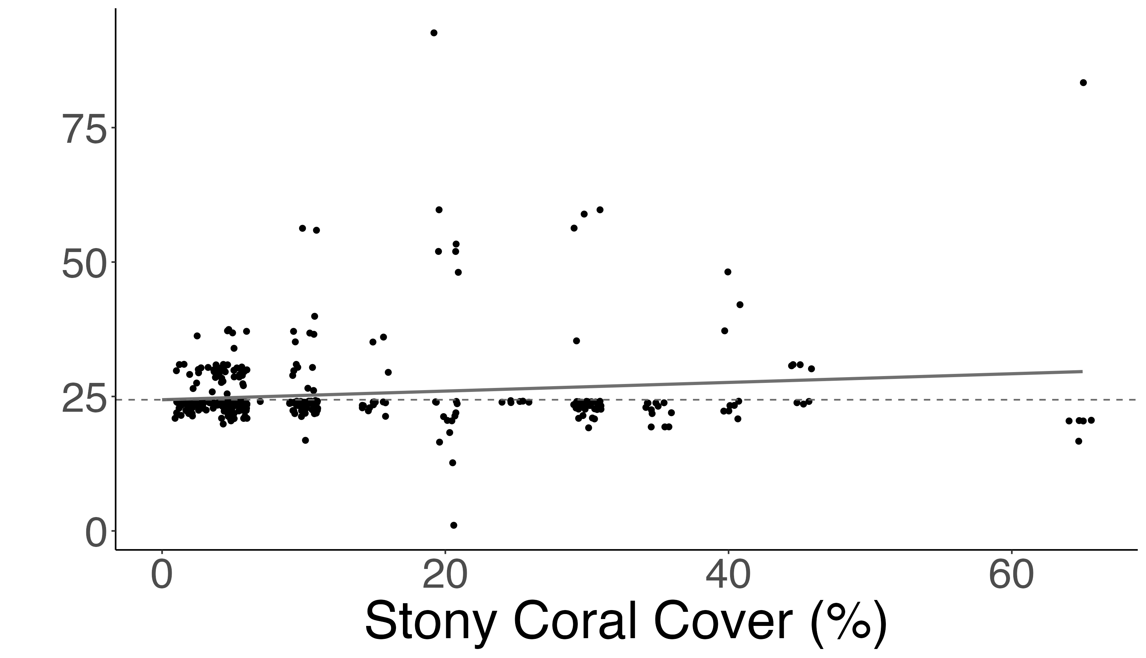
A.
a
b
SVC Density Greater
Belt Density Greater
B.
b
Density Difference (individuals/m²)
SVC Density Greater
a
Belt Density Greater
C.
SVC Density Greater
estimate = 0.035
z-value = 2.90
p < 0.01
Belt Density Greater

Slide 19
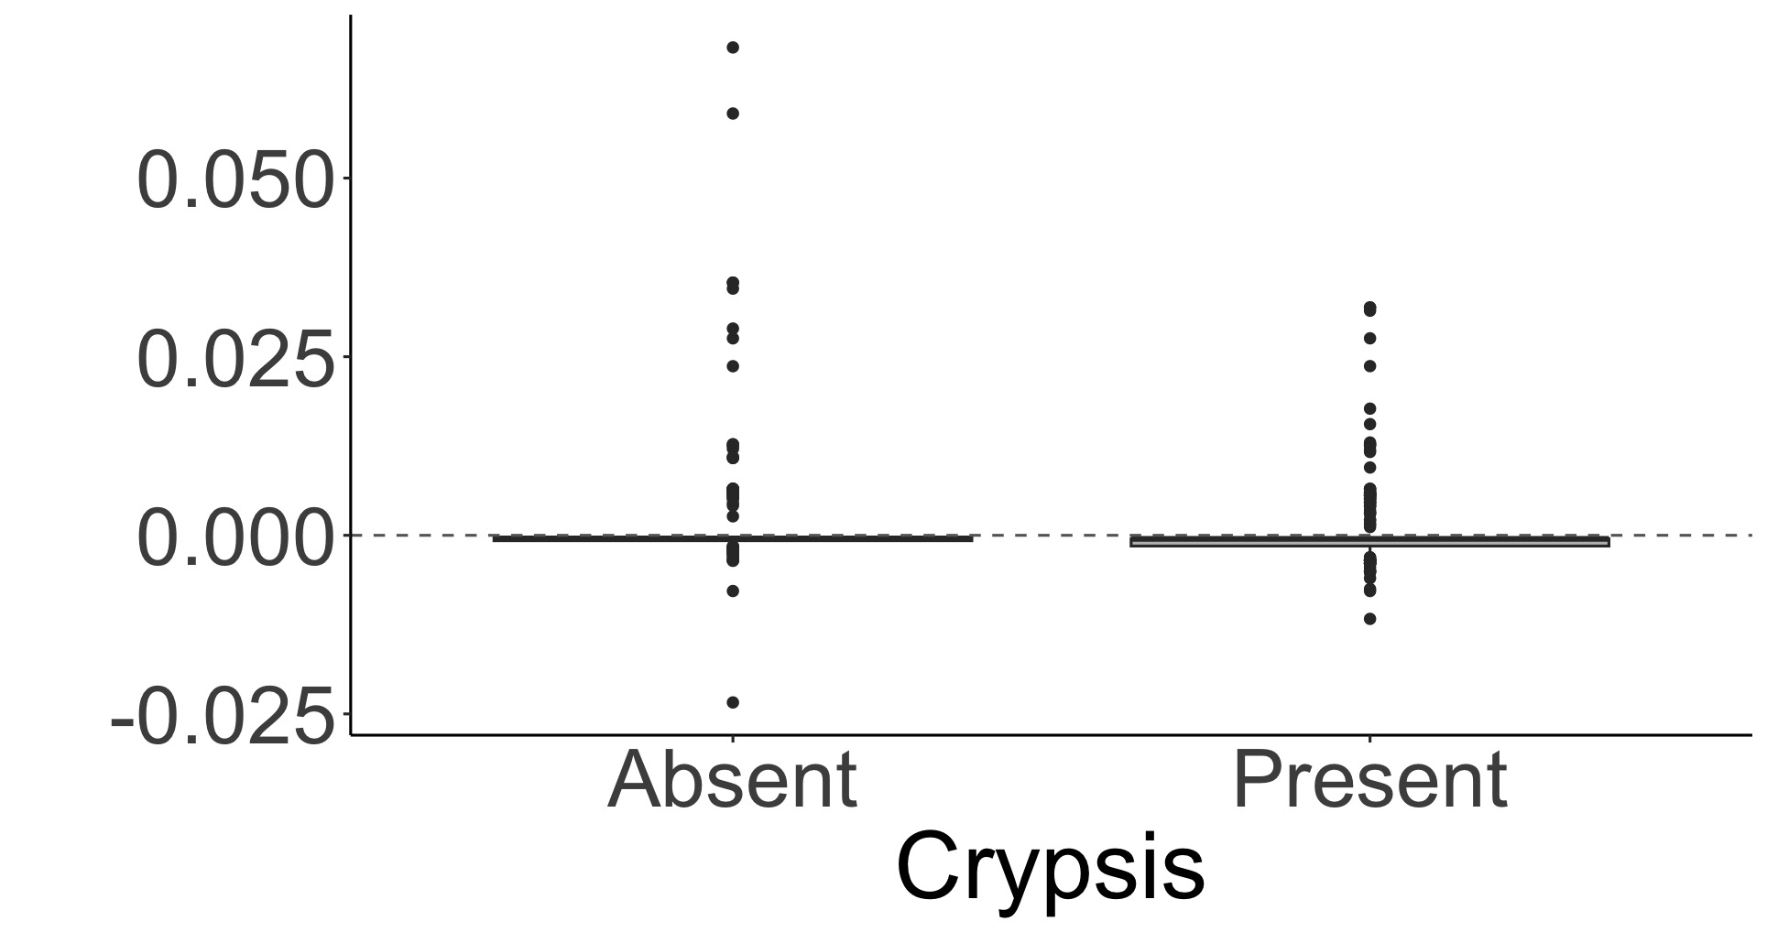
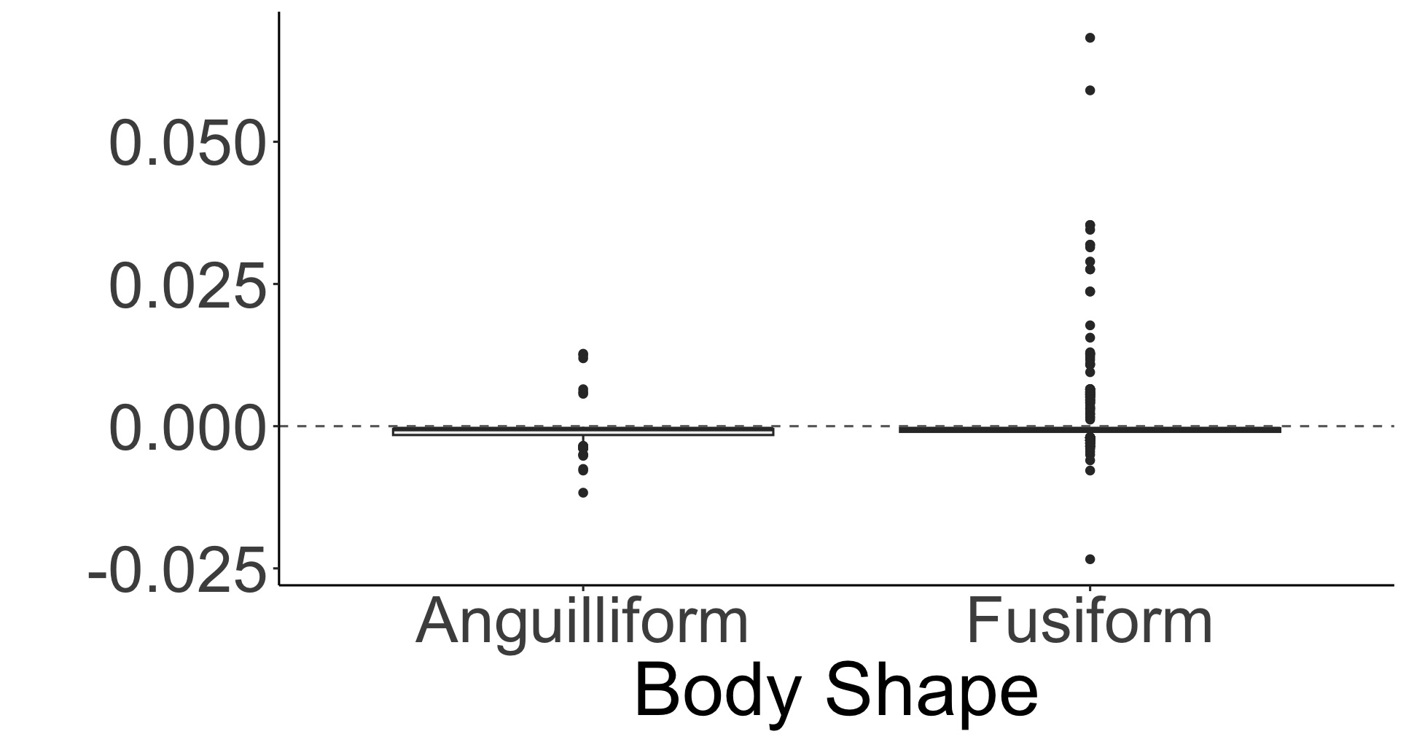
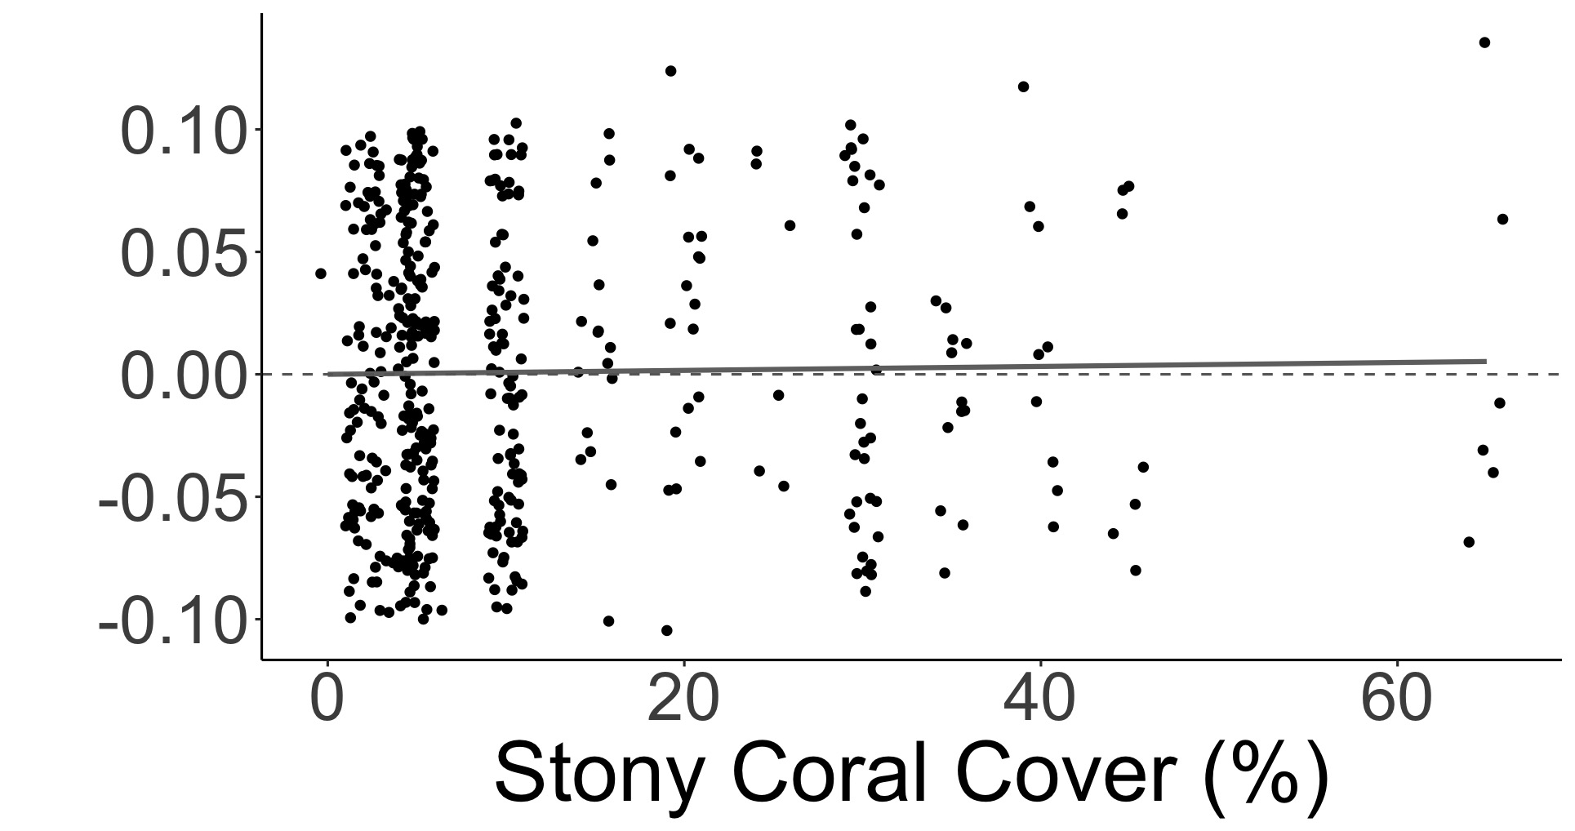
A.
a
b
SVC Density Greater
Roving Density Greater
B.
b
SVC Density Greater
a
Density Difference (individuals/m²)
Roving Density Greater
C.
SVC Density Greater
Roving Density Greater

Slide 20
SVC vs. Belt Diagnostic Plots

Slide 21
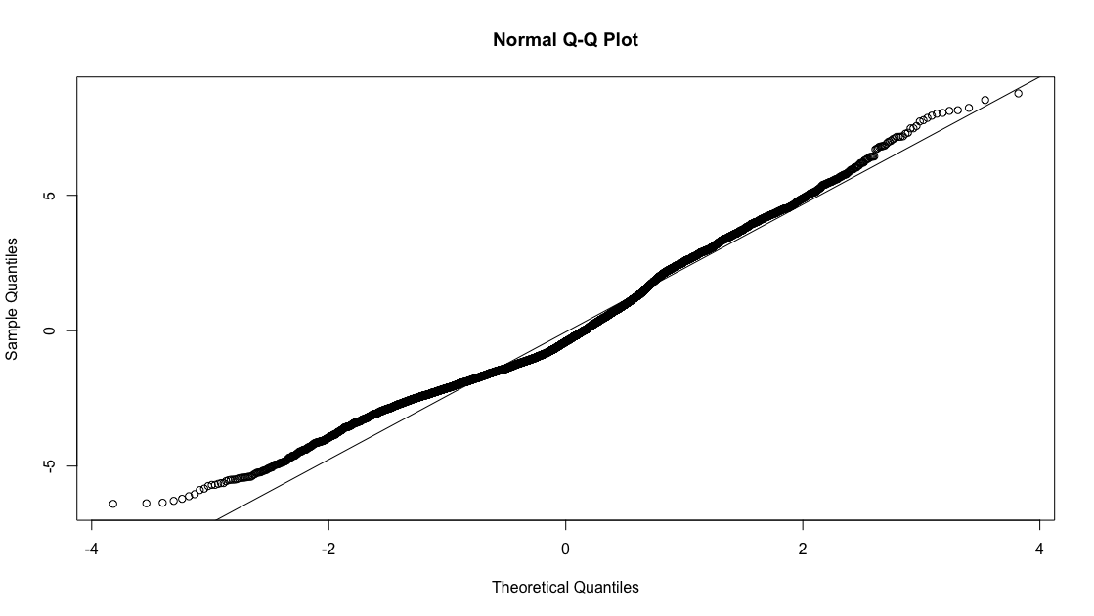
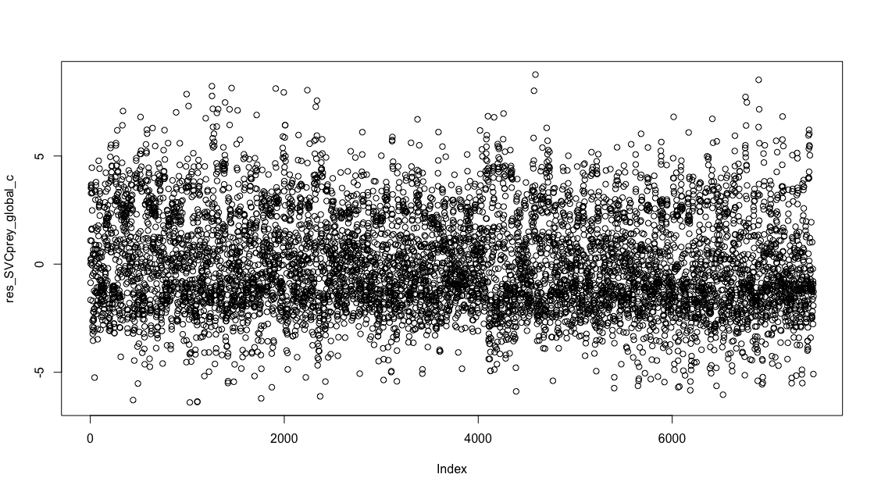
A.
B.

Slide 22
SVC vs. Roving Diagnostic Plots

Slide 23
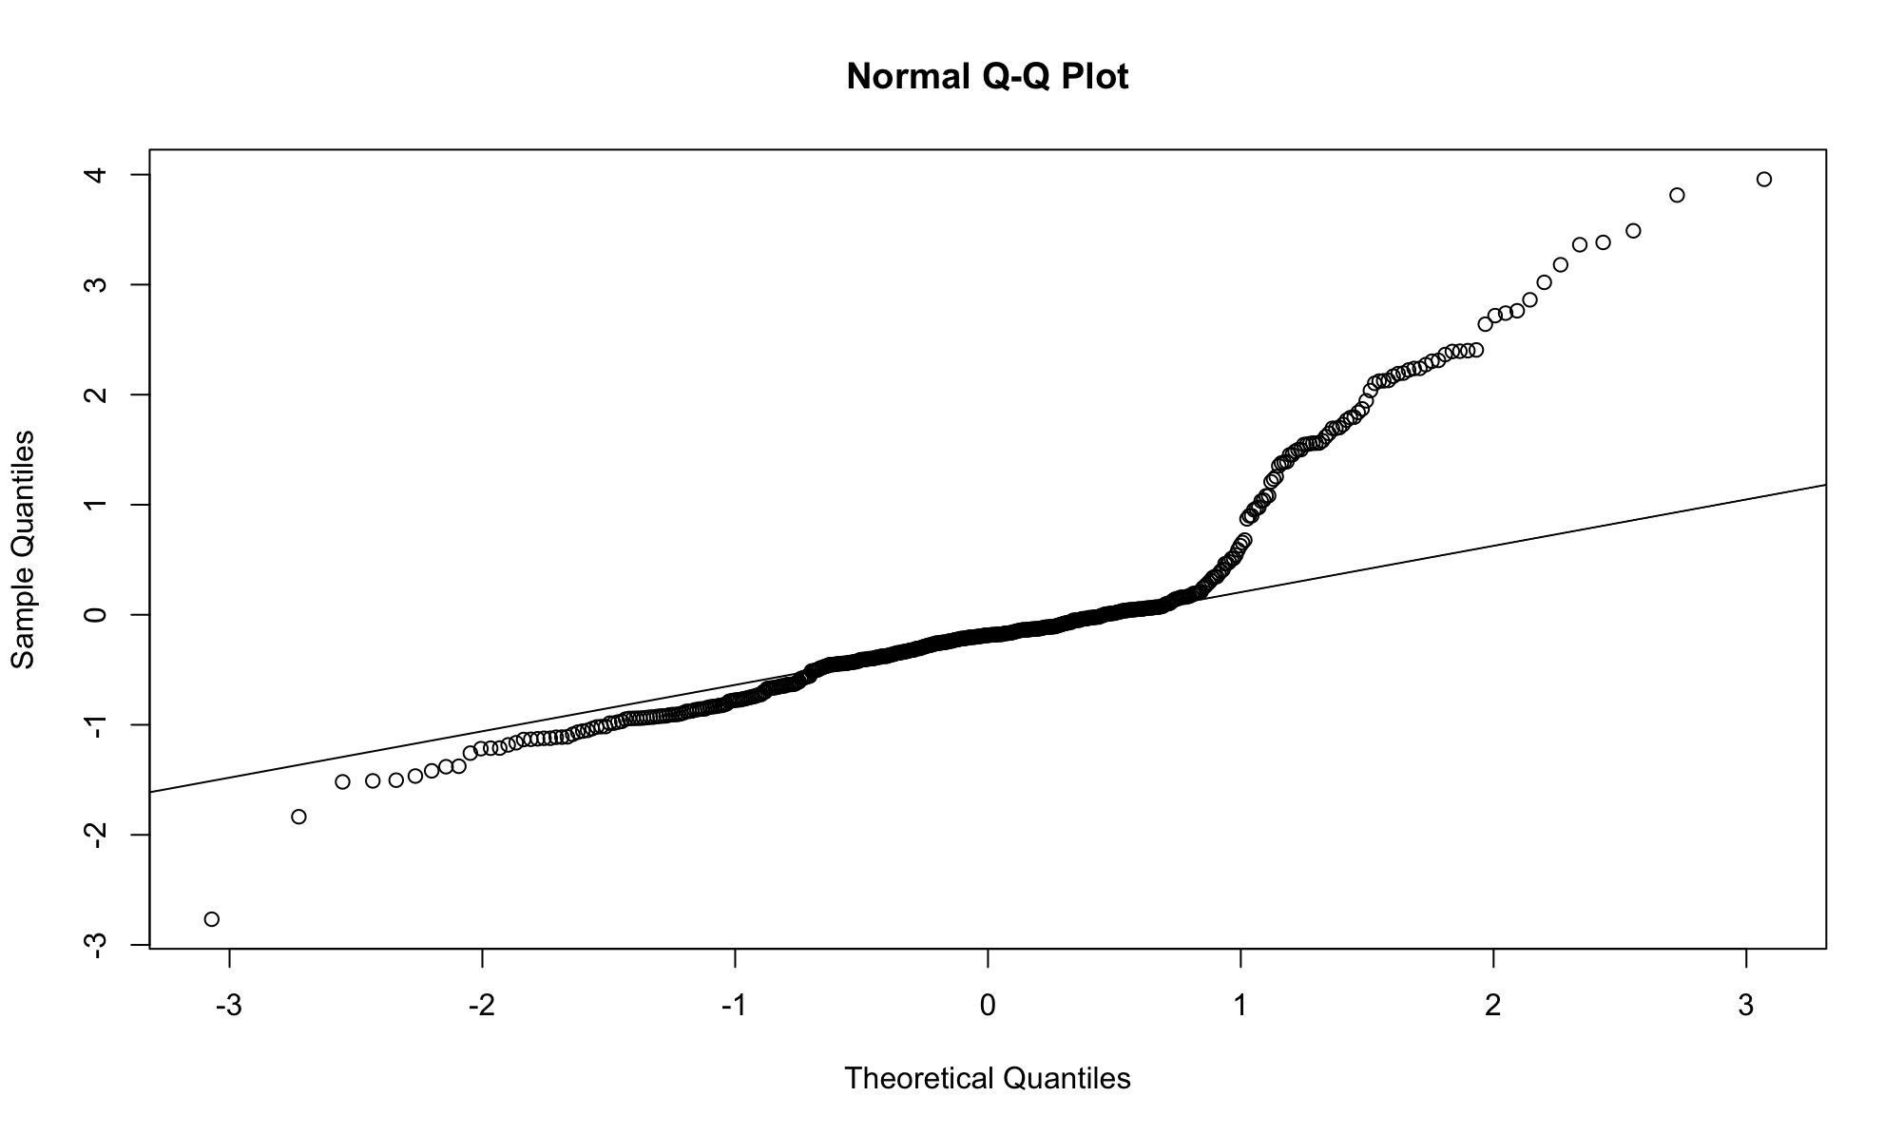
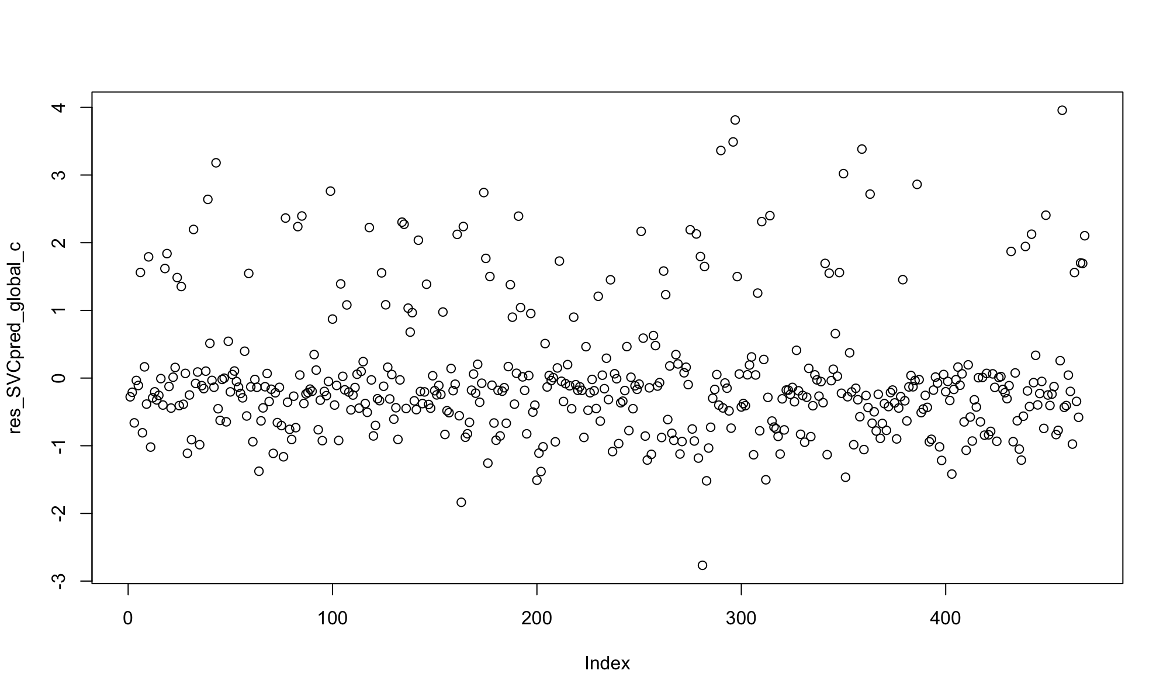
A.
B.

Slide 24
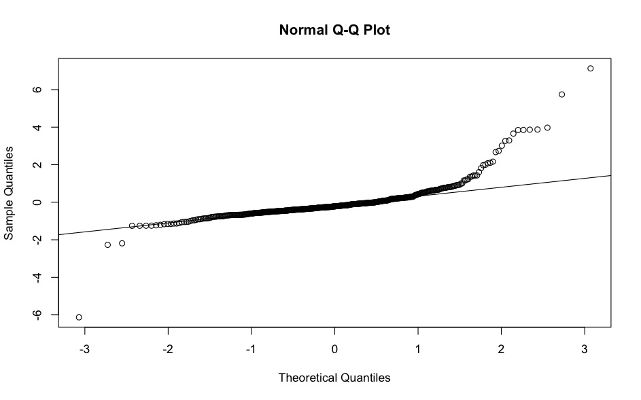
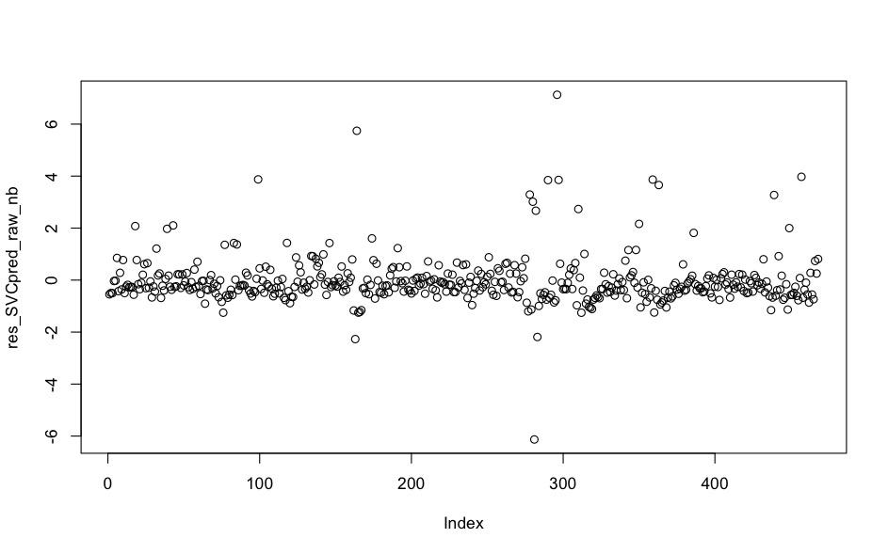
A.
B.

